Slide 1
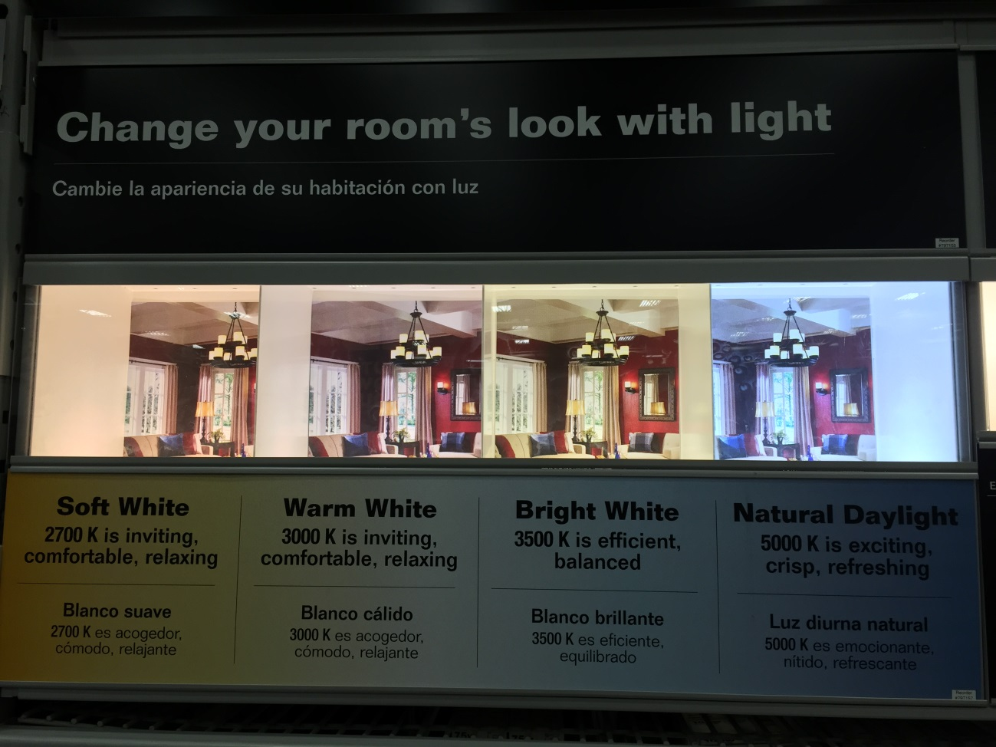
Soft or warm white- yellowish white, give a “warm” feeling
(2,700 K -3,000 K)
Bright white/ neutral white- no added colors (3,500 K)
Daylight- bluish, white light, like a slight overcast sky (5,000 K)
Colors of Light Bulbs
Pic taken from Lowe’s

Slide 2
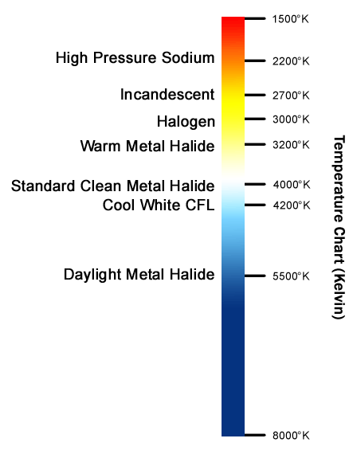
Colors of Light Bulbs
Soft/warm
Kelvin (K) Unit- measures the color temperature
Example- heat steel - starts off red color, yellow, white, blueish white, finally blue at its hottest
Neutral/bright
daylight
Pic from techsupply.com

